Slide 1
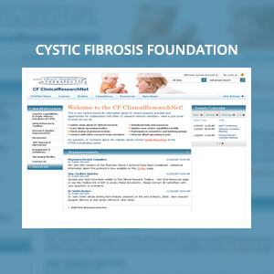
Cystic Fibrosis Foundation
The Challenge
<p>A large hospital network, which was responsible for managing clinical trials for The Cystic Fibrosis Foundation, came to Affirma when they needed a way to increase the speed and quality of patient assignments to clinical trials. Our client wanted a collaborative software solution that would make this process more efficient across various care centers while improving the overall quality of patient care.</p>
What We Did
<ul>
<li>Provided business management consulting to understand business processes.</li>
<li>Implemented Microsoft SharePoint 2007 Portal Extranet hosted in a medium farm with ISA Server.</li>
<li>Collaborated with the IT department at The Cystic Fibrosis Foundation in order to successfully deploy the CFCRNet Portal.</li>
</ul>
Results
<p>The resulting SharePoint portal increased the speed and quality of the collaboration process for clinical trial assignments by 15%-25%. Our client was very pleased with the results, as it allowed for better patient care.</p>

